Slide 1
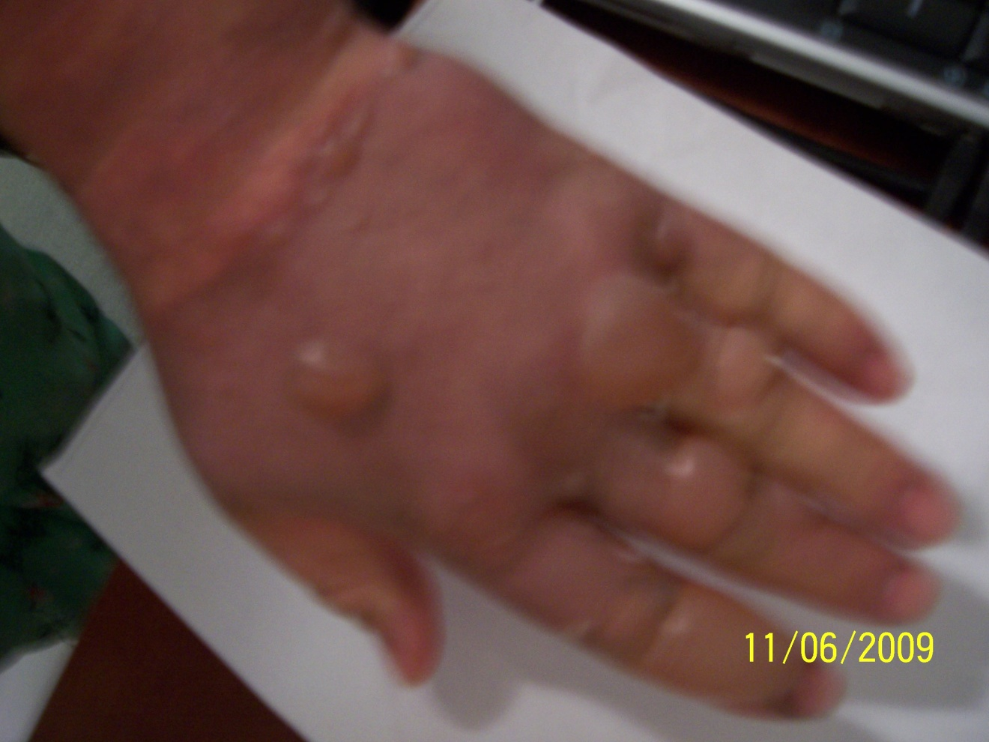
Ozone and Burns
Burn happened Nov 4, Day 2 from the burns, day 1 of treatment w/ Ozone. Treatment consists of 25-30 minute sessions twice daily (morn & even), immediately after showers. In between ozone treatments, the burns were dressed with bandages & silvadene.

Slide 2
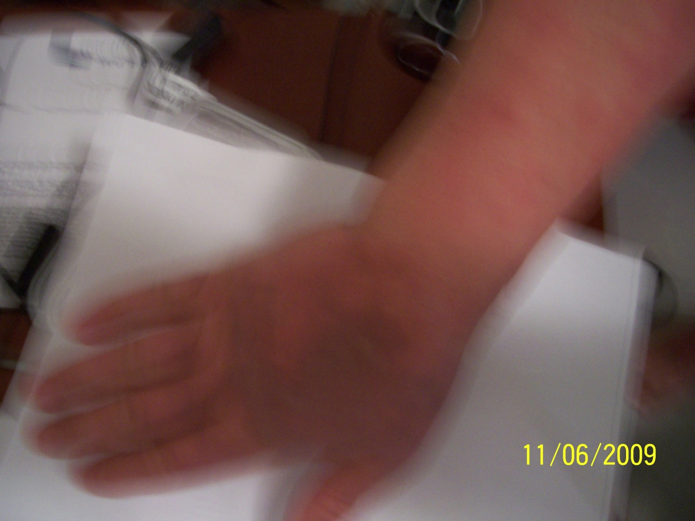
Sorry for the blur, Day 2 also Right hand, first and second degree burns here. Treatment is sitting in ozone sauna for 25-30 minutes twice a day (morn & night) immediately after showering, no heat was applied with the sauna, only pure ozone.

Slide 3
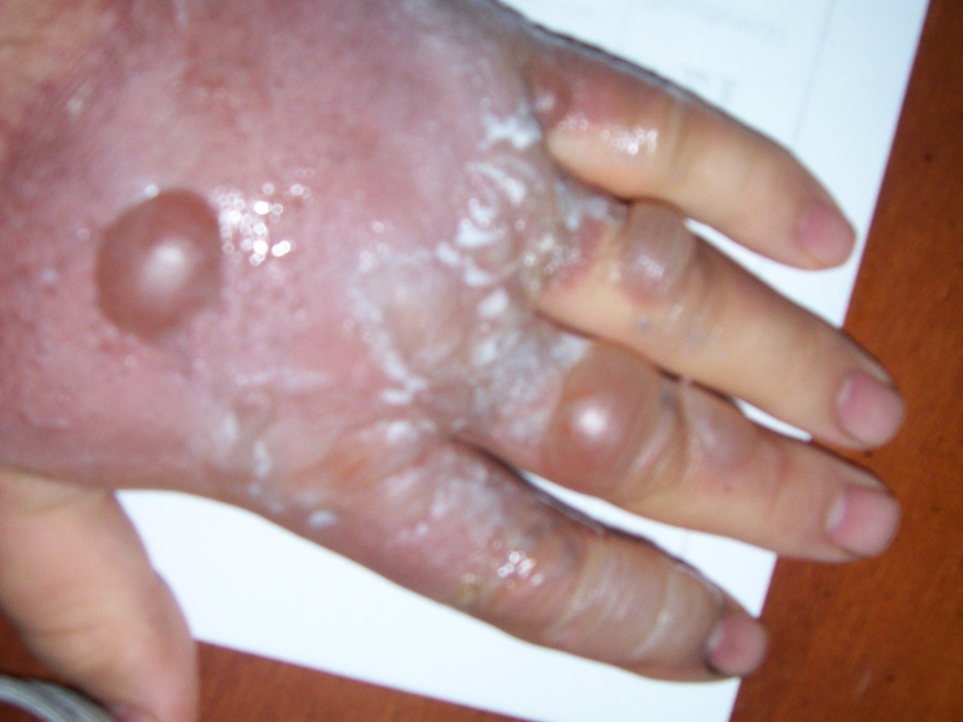
Day 3 of treatment, Day 4 from the actual burn, left hand pictured
Left hand received the worst damage (second and third degree burns)

Slide 4
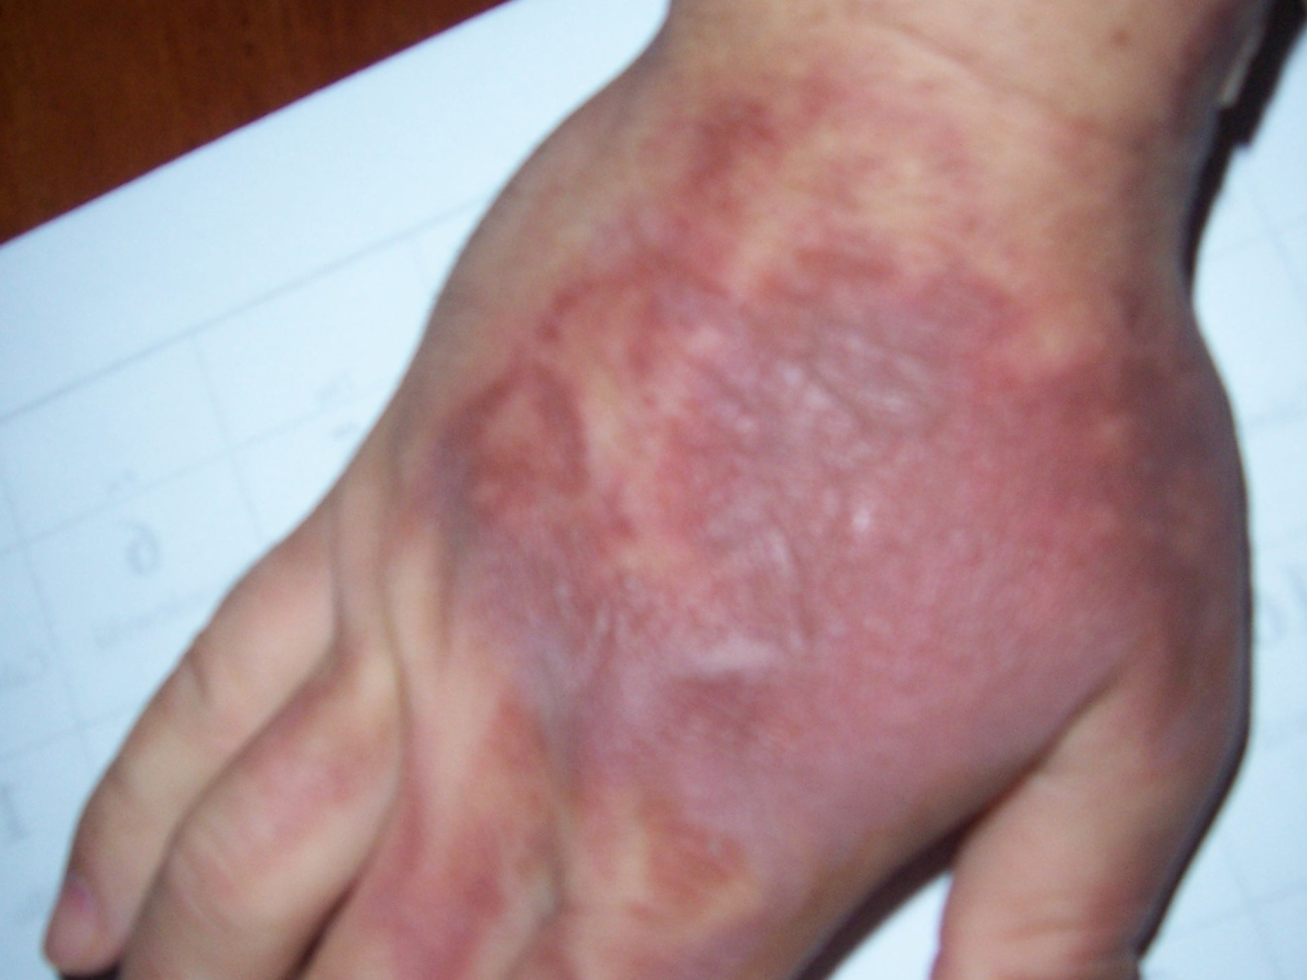
Right hand shown, Day 4 of treatment, still doing ozone sauna (no heat) twice a day for 25-30 minutes, immediately after showering

Slide 5
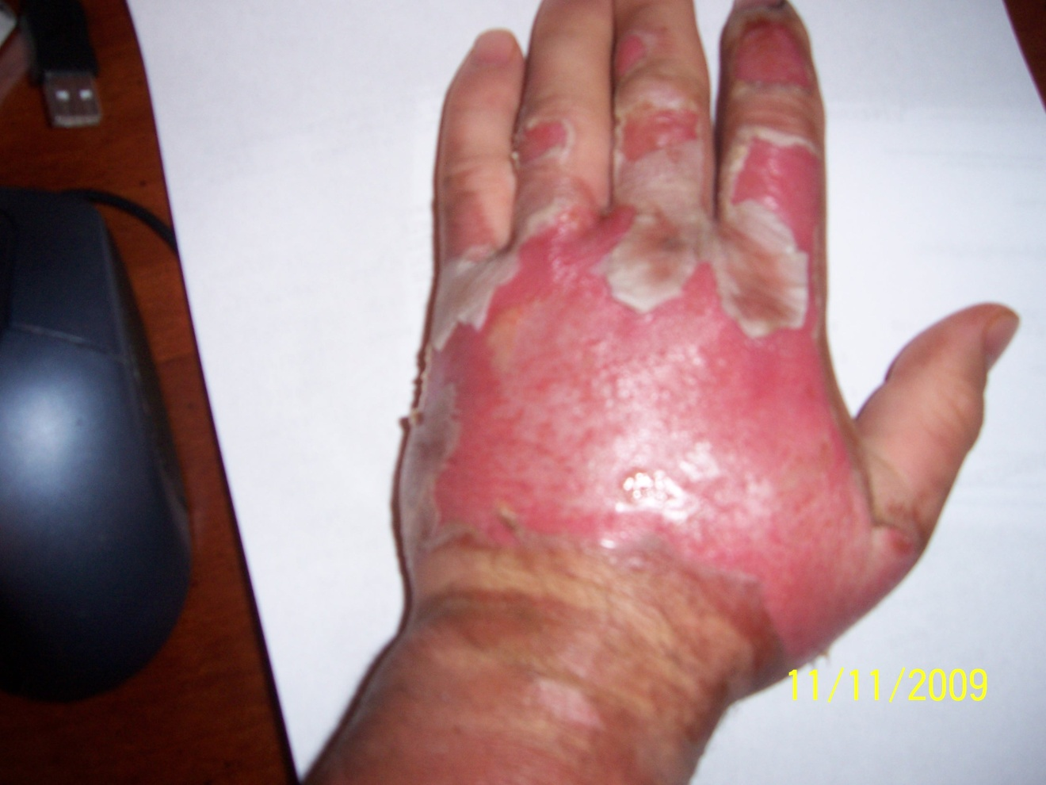
1 week from the burn, day 6 of treatment, still doing ozone twice a day for 25-30 minutes

Slide 6
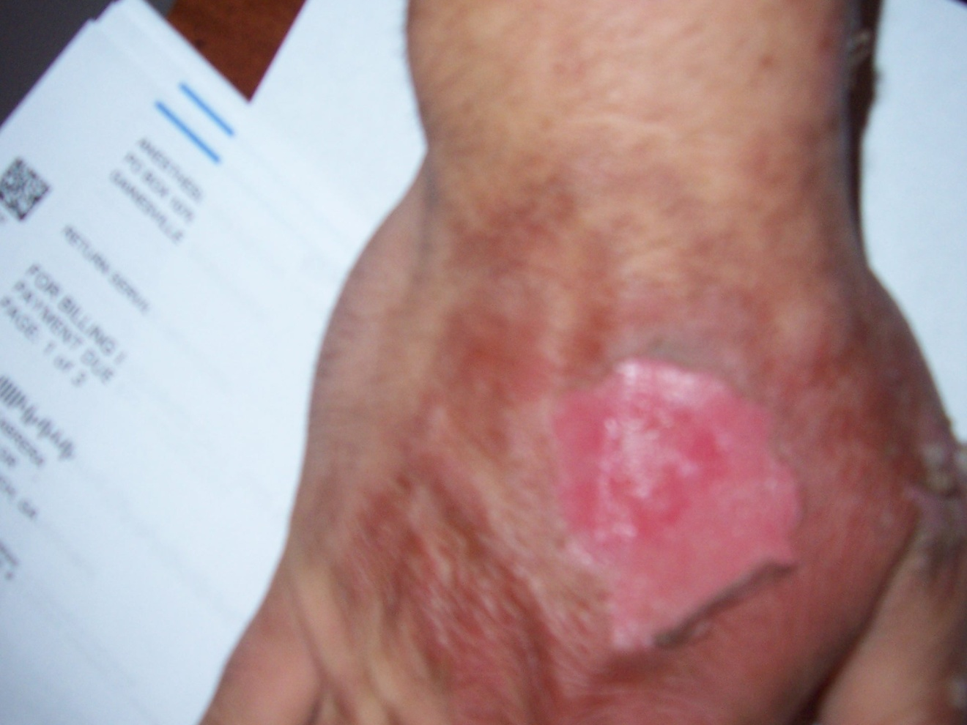
1 week from the burn, day 6 of treatment for right hand, wound is almost completely healed on this hand

Slide 7
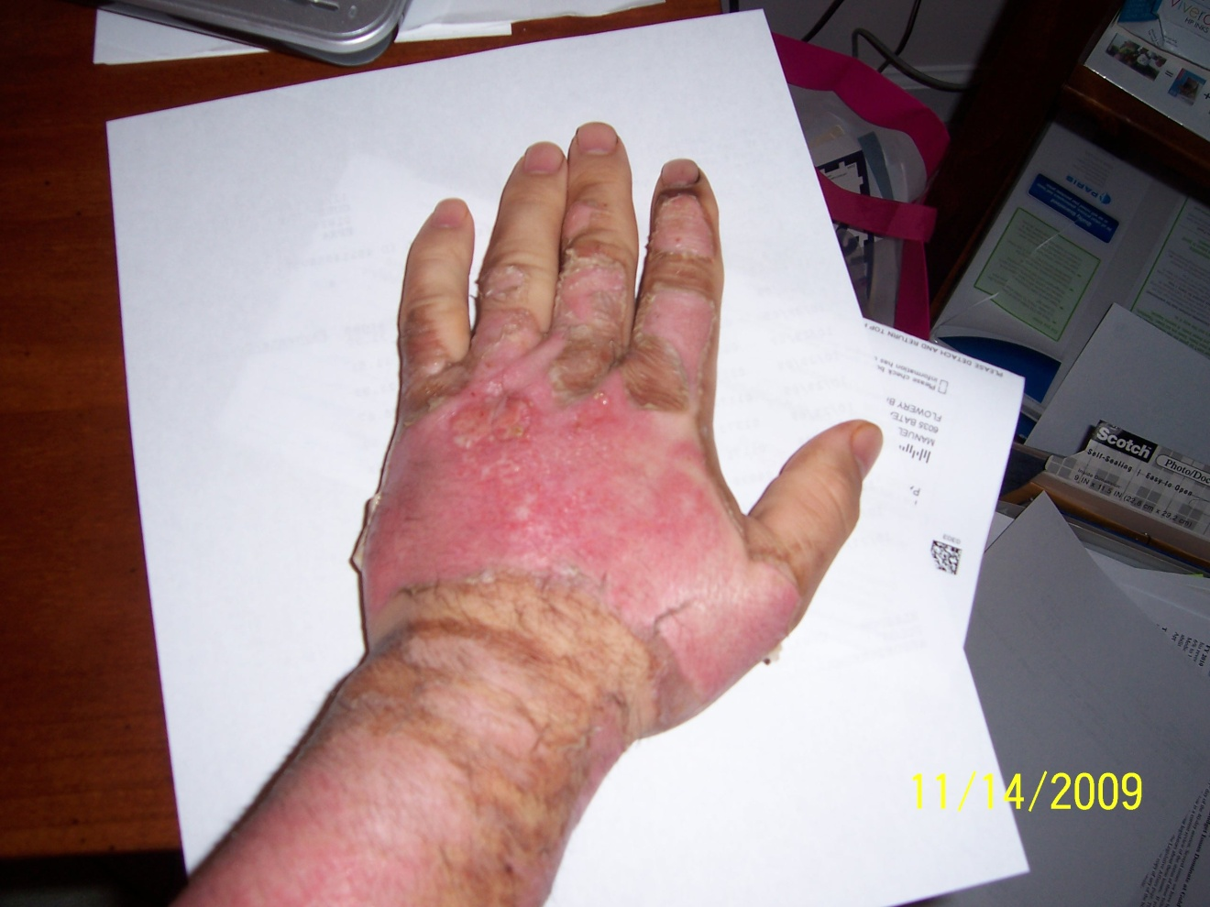
Day 10 from the injury, day 9 of treatment. Completely new skin is formed from second and third degree burns. Average time for new skin on second degree burns is 17 days, I did it in half the time, my plastic surgeon is shocked

Slide 8
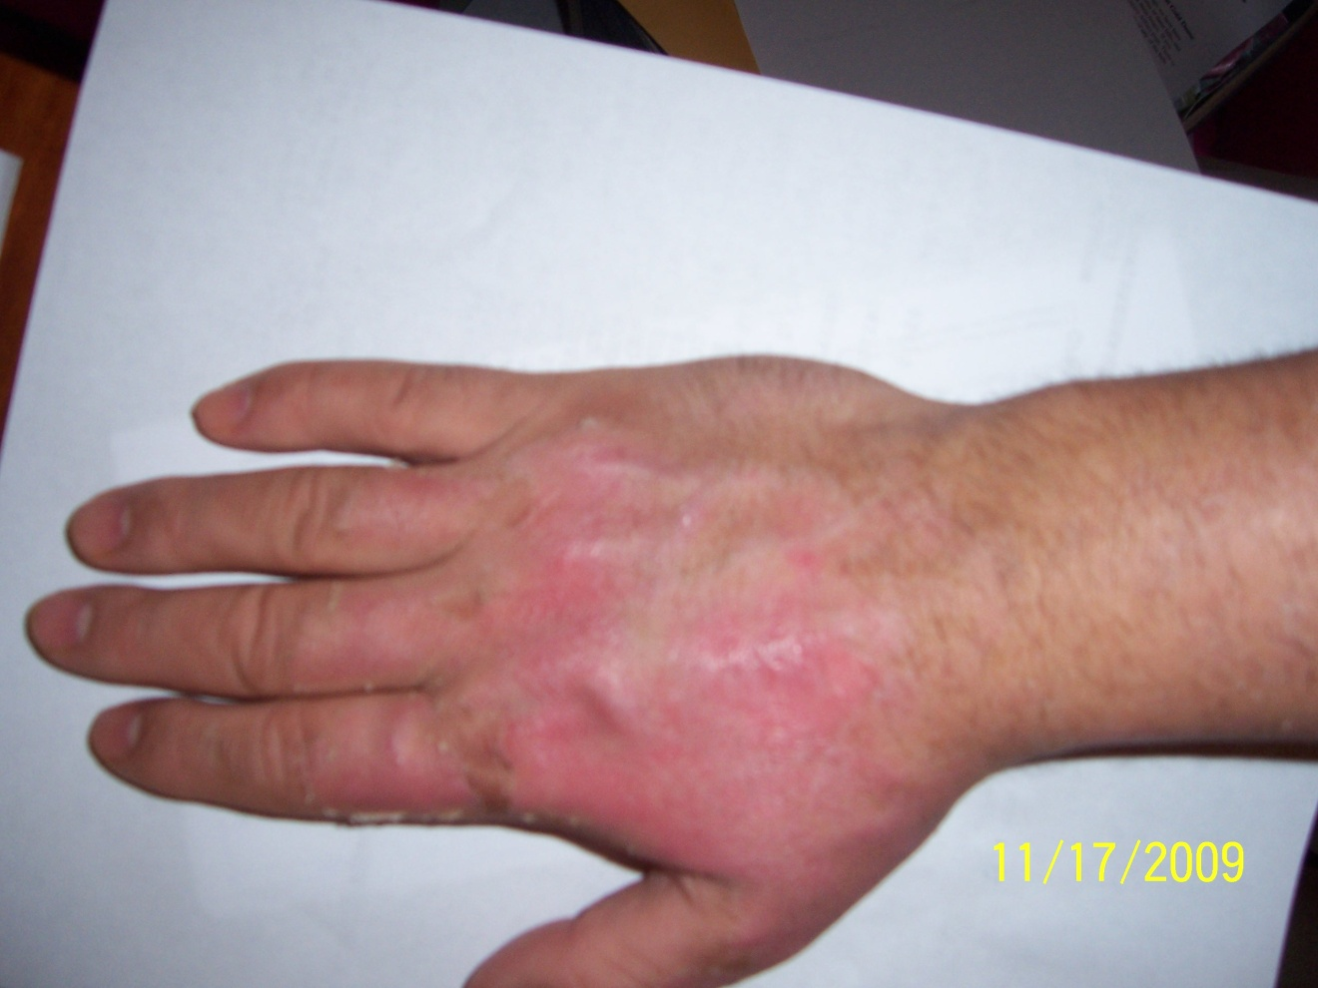
Right hand is completely healed from first and second degree burns at 9 days of treatment.

Slide 9
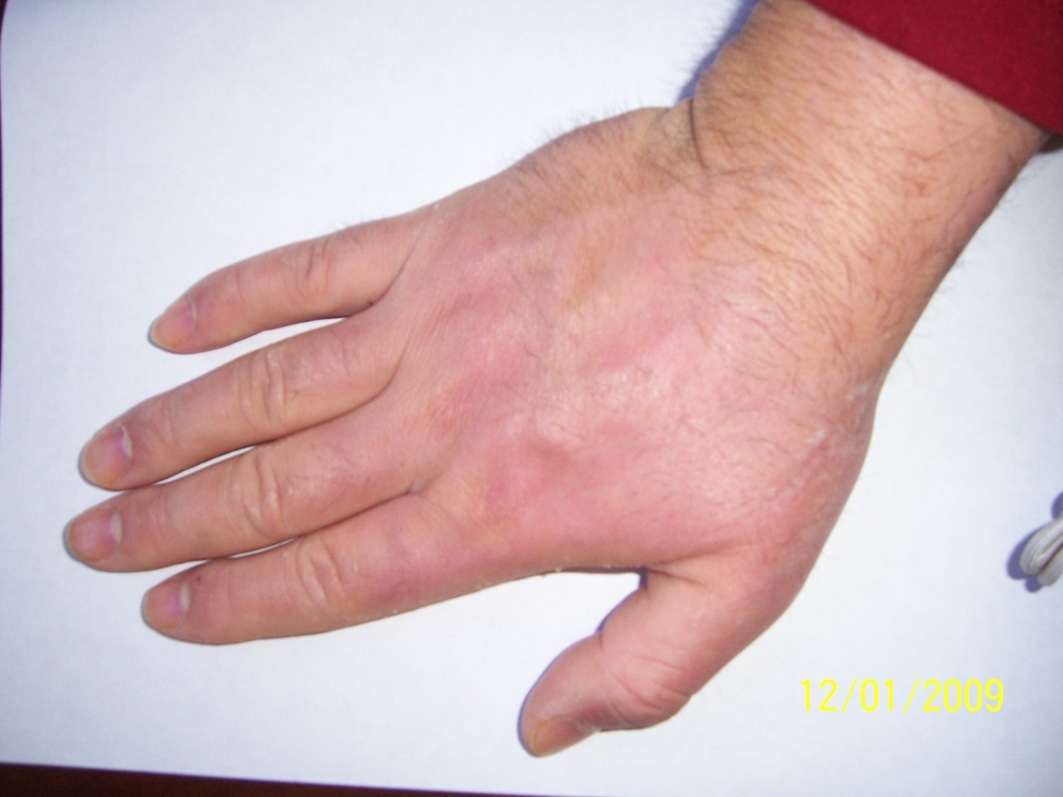
Right hand, 27 days after the burn, 26 days of treatment. As an aside I have a small penny sized scar on the underside of my right arm, the scar is 25 years old, it is disappearing.

Slide 10
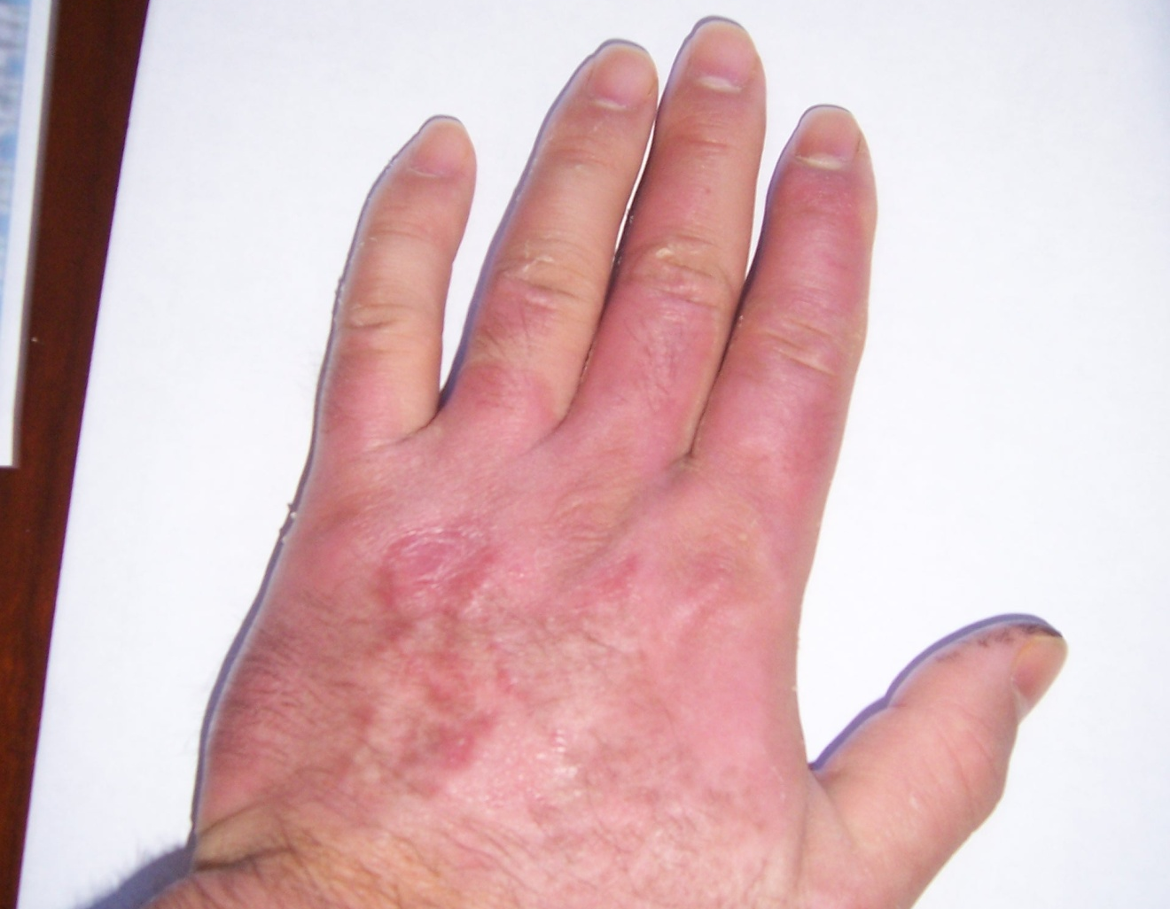
Day 27 from the burn, second and third degree burns are completely healed

